Slide 1

Global Optimization of Gas Lifting Operations
A Comparative Study of Piecewise Linear Functions
Original Work:
Ruth Misener, Chrysanthos E. Gounaris and Christodoulos Floudas
Replicated By:
Aastha Jhunjhunwala & Yash Gokhale

Slide 2
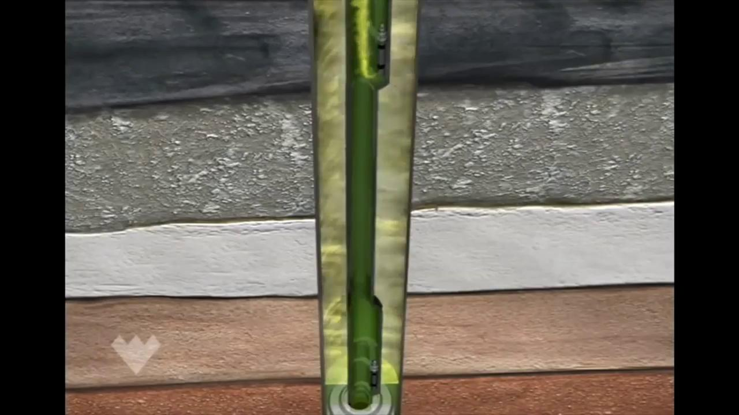
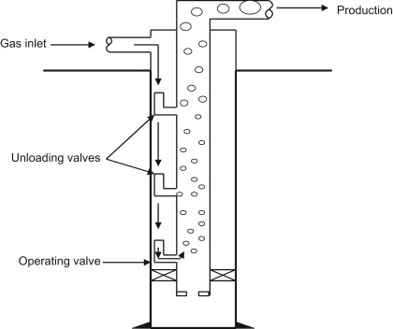
What is gas lifting?
Notes:
Injection of CNG (lift gas) into the production tubing of an oil well.
Weight of the column of fluid is reduced thus increasing the pressure gradient between the reservoir and well fluid
The fluid gets pushed to the surface.
The fluid (oil, gas, and water) is treated to separate water.
The oil is sold, the leftover gas is either sold or recycled for use in another gas lifting operation.

Slide 3
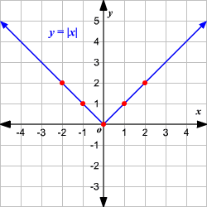
Piecewise linear functions
A piecewise linear function is composed of a number of linear segments defined over an equal number of intervals, usually of equal size, eg: Absolute Function
4 Methods of formulation using Piecewise Linear Functions:
Classic Method
Linear Segmentation Method
Convex Hull Method
Special Structure Method
These methods use different combinations of weights for activation of the linear segments.

Slide 4


Problem Overview
Sets: i : No of wells (In this case 6 wells, 56 wells and 200 wells case)
k: No of vertices (v1-v12)
Objective Function:
Where, 𝛌 is the weight vector and q_{OIL} is the rate of oil production corresponding to each well and each vertex.
Gas injection limit:

Slide 5
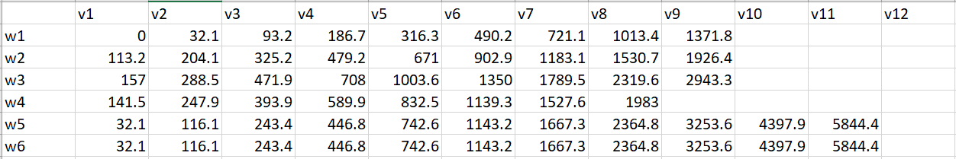
Data Set
Vertices
Wells
Gas Injection Rate (q_{GAS}) (6 well case)

Slide 6
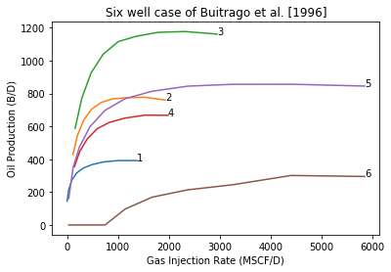
Necessity of a MILP Formulation
Although the problem is perfectly linear, introduction of additional binary variables is necessary
Specific Case is Highlighted:
Well 6 does not start producing oil as soon as lift gas is injected
This lag leads to non-convexity
If pathological wells like well 6 are absent, an LP formulation can be used

Slide 7
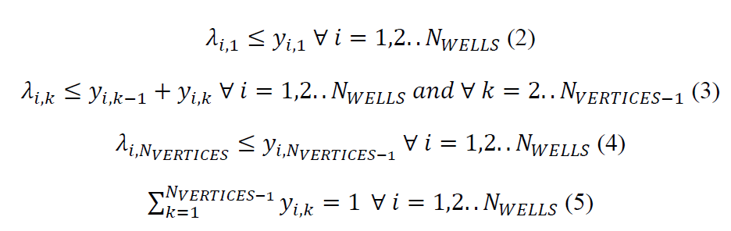
Classic Method
This model forms the basis for the other 3 models
Separate constraint for the 3 kinds of vertices:
Starting
Intermediate
Terminal
Equations (2-4) limit the positive variables lambda to be less than the binary variable representing that line segment. This ensures that there is only a single entry and exit vertex is activated for every well.
(1)
(2)
(3)
(4)

Slide 8
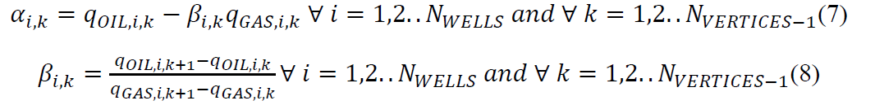
Linear Segmentation Method
An update to the classic method
The striking difference between CM and LSM is the inclusion of the slope 𝛽 and intercept term 𝛼 in the objective function.
Parameters 𝛼 and 𝛽 are evaluated for every well and vertex as:

Slide 9

Special Structure Method
Convex Hull Method
SSM implements the fact that any two λ_{i,k} values should be adjacent without the introduction of a binary variable.
In GAMS this can be implemented by declaring the variable as an SOS2 variable.
No extraneous Branch and Cut implementation is required.
Simple and most efficient of all the other models
In this formulation, the combination weight is split into two parts, left and right.
λ^{L} ∈ [0, 1]^{N}_{WELL}^{N}_{VERTICES-1} and λ^{R} ∈ [0, 1]^{N}_{WELL}^{N}_{VERTICES-1} , are continuous variables

Slide 10
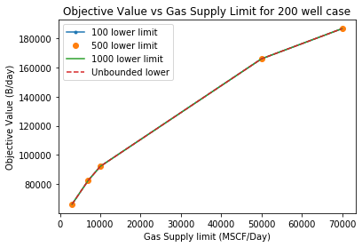

Addition of a lower bound to Injection limit
Problem is generalized through the addition of a lower bound on the oil injected
The effect of rate of injection on the objective value was analysed
Results were in accordance to literature
Absolute difference in the objective value was insignificant
Ensures a more inclusive model

Slide 11
Analysis of Proposed Models
Classic Model forms the basis for the other 3 higher models
LSM is a robust Big-M formulation with higher computation time
CHM ensures equivalence with the convex hull of the original constraint
SSM is computationally fastest as it uses SOS2 variable, eliminating the use of binary variables SOS2: If there are 2 positive variables, it should be consecutive
GAMS, CPLEX has built in implementation of SOS2

Slide 12
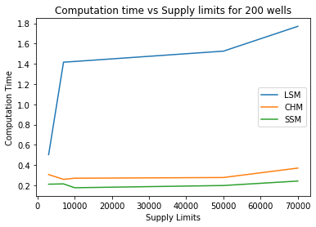
Relative Comparison of Methods
Robust but Slower
Computationally
Similar

Slide 13


Higher Order Models
Newton Reduction Method and Lagrangian Multiplier Using KKT conditions of Optimality (Karush-Kuhn-Tucker)
SLP: Sequential Linear Programming through a Taylor Series Approximation of the Lift Gas Curve
SQP: Sequential Quadratic Programming through Hessian Update Procedure
Tabu Search Method for complicated curves
Neural Network based Production Simulation Method

Slide 14
THANK YOU!
&
QUESTIONS?

